Slide 1

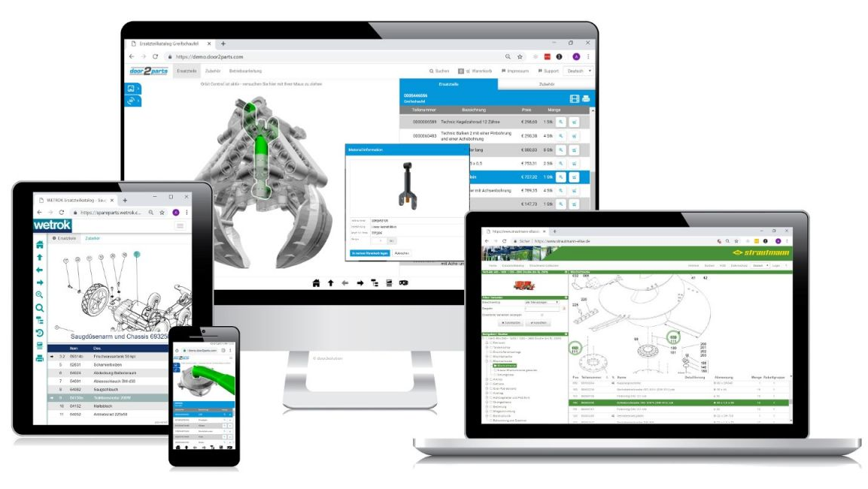
PRODUCT DEFINITION DOCUMENT
DIGITAL SPARE PARTS CATALOG
Create by & Date : Yusak / 30 October 2023
Last Update By / Date : Yusak / 31 October 2023
PT Berlian Sistem Informasi (BSI)
Confidential – Internal Used

Slide 2
Agenda
PRODUCT TEAM OVERVIEW
BACKGROUND & PROBLEM DEFINITION
USER PERSONA & USER ACCESS
USER FLOW
COMPETITOR COMPARISON
RECOMMENDATION NEW UI DESIGN
RECOMMENDATION NEW DATA FLOW
FEATURE LIST & PRIORITIZATION
SUCCESS MATRICS
GO TO MARKET
PT Berlian Sistem Informasi (BSI)
Confidential – Internal Used

Slide 3
PRODUCT TEAM OVERVIEW
Company Name |  |  | Date | Created By
MMKSI |  |  | 31 October 2023 | Mr. Yusak Indra H.
PM Leader | PM Product | Team Product Management | Product Owner | Scrum Master | Business Owner | Product Operation | Business Users | Business Users
Mr. Yusak | Mr. Noorman | PM Dealership (Mr. Angga) PM After Sales (Mr. Achmad Zulfikar) | Microsite : Mr. Budi, Mr. Ciputra SOA : Riza Fathony DMS/DNET : Mr. Zulfikar MOE : Mr. Mahdhika Website : Mr. Axel MMID : Mr. Rizky | Mr. Yusak | Mr. Hilman Rahmat Permana Mr. Adam Rahman Mr. Hatta Harris Rahman Mr. Bintar Prakoso Mr. Dwi Ahadianto | Mr. Budi | Mr. Dwi Ahadianto Mr. Rieza | Mr. Hilman Rahmat Permana Terentia Milyanti Azalia Hatta Harris Rahman Donny Septianto Yodi Abraham Firda Thalika Adisty Mega Purwati Aztari Ayu Nadya
EPICS |  |  | Impacted to System Product | Impacted to Business Product
[Product: Microsite] Digitalize Spare Parts Catalog |  |  | D-NET, SOA, Microsite, MoE, Website , MMID | [EPICS] E-Com Spare Parts
Version Update
Version 0.0 : Initial creation document Product Requirement Definition (PRD) Digital Spare Parts Catalog
Product Vision |  | Product Mission | Product Objective | Product Principle |  | Tracking & Data Analytics |  | Go To Market
Ecosystem which seamless, intuitive, and comprehensive platform that simplifies spare part identification, selection, and procurement, ultimately enhancing operational efficiency and provide customers and businesses interact with Mitsubishi source spare parts. |  | Ecosystem for all technical documents, manuals, bulletins and spare parts drawing in one place. | Central Digital Platform for User Access Spare Parts Catalog | Features are needed and used by End Customer Mitsubishi |  | Customer tracking behavior and analytics process |  | March Week 2
Reference Document
(1) Discussion Material and Minutes of Meeting Digital Spare Parts Catalog
PT Berlian Sistem Informasi (BSI)
Confidential – Internal Used
3

Slide 4
Product Digital Spare Parts Catalog - Overview
INTRODUCTION
Currently Vehicle Part Catalogue of Mitsubishi is using two ways :
Using Caps Application and Print as Hardcopy. For Original Caps Data from MMC, MMKSI are costly in Quarterly and Hardcopy is preparing to accommodate business partner like Part Shop and Fleet Customer.
PRODUCT VISION – Microsite Spare Part Catalog
Ecosystem which seamless, intuitive, and comprehensive platform that simplifies spare part identification, selection, and procurement, ultimately enhancing operational efficiency and provide customers and businesses interact with Mitsubishi source spare parts.
PRODUCT MISSION – Microsite Spare Part Catalog
Ecosystem for all technical documents, manuals, bulletins and
spare parts drawing in one place and can be accessed by users.
KPI – Indicator for Monitoring
% Number of user Access
% Number of License CAPS Decrease
% Increase Customer Experience with Notification and information
PT Berlian Sistem Informasi (BSI)
Confidential – Internal Used

Slide 5


Problem Definition and Solutions
Current Process
Below are current condition of Spare Part Catalogue distribution to dealers in MMKSI:
3
4
5
Mitsubishi
ASA (CAPS) Application
Dealer A
Part shop A
1
Catalogue
Book
Catalogue
Book
Dealer B
Part shop B
MMKSI User
2
Price
Book
Mitsubishi
SAP Application
Price
Book
Dealer C
Part shop B
Process Flow Detail :
MMKSI user extract information’s from ASA Application and of :
Parts data in Txt format
Parts image in jpg format
Information of ASA then compiled into Catalogue Book that distributed to dealers.
MMKSI user open SAP application to extract information of parts prices and export/printed into price book.
MMKSI share access of ASA application, catalogue book, and Price book to dealers (based on request).
Dealer distribute catalogue book and price book to Part shop's based on Part shop's demand
PT Berlian Sistem Informasi (BSI)
Confidential – Internal Used
5

Slide 6
Problem Definition and Solutions
Current Process (cont.)
Below are current condition of Spare Part Catalogue distribution to dealers in MMKSI:
3
4
5
Mitsubishi
ASA (CAPS) Application
Dealer A
Part shop A
1
Catalogue
Book
Catalogue
Book
Dealer B
Part shop B
MMKSI User
2
Price
Book
Mitsubishi
SAP Application
Price
Book
Dealer C
Part shop B
Problems :
 | Manual effort of data extraction and compiling information takes a lot of time (4 – 5 months) Hardcopy distribution impacting of delayed information : Price updates (redistribute for price book or reconfirm price before purchase) Any updates in Catalogue information
 | Labor cost of extraction and compiling (4 – 5 months) Printing and distribution of Catalogue book & Price book Any parts return impact of wrong parts delivered
Cost
Lead Time
 | Hardcopy is not user friendly for searching information
PT Berlian Sistem Informasi (BSI)
Confidential – Internal Used
6

Slide 7
Problem Definition and Solutions
Solutions
Below are proposed To-be Process of Spare Part Catalogue information distribution in MMKSI:
1
Solved Problems
Solution
4
Mitsubishi
ASA (CAPS) Application
Manual effort of data extraction and compiling information takes a lot of time (4 – 5 months) Labor cost of extraction and compiling (4 – 5 months) | Each year BSI will provide professional service of one model data extraction and migration from ASA application to Mitsubishi Part Catalogue application (20 working days)
Delayed information impact of hardcopy channeling (MMKSI-Dealers-Part Shop) distribution : Price updates (redistribute for price book or reconfirm price before purchase) Any updates in Catalogue information Printing and distribution of Catalogue book & Price book | Dealer user and Part shops user will open Mitsubishi Parts catalogue to access Spare parts information includes with its spare parts price information's.
Any parts return impact of wrong parts delivered | Parts return will be reduced due to information in Part catalogue is user friendly and have better information.
PDF/Hardcopy part catalogue is not user friendly for searching information | Implement user friendly feature in Digitalize Part Catalogue (see appendix 3)
Dealer A
3
Mitsubishi
Part Catalogue
Application
Dealer B
MMKSI User
2
Partshop A
Mitsubishi
SAP Application
Partshop B
Process Flow Detail :
BSI will assist MMKSI for extracting information’s from ASA Application of
Parts data and Parts image.
Upload data to Parts Catalogue Application
SAP application integrated with Mitsubishi Part catalogue for spare parts price information integration.
Information of parts detail and price will be displayed in Mitsubishi Part Catalogue.
Dealer user and Part shops user will open Mitsubishi Parts catalogue to access Spare parts information.
PT Berlian Sistem Informasi (BSI)
Confidential – Internal Used
7

Slide 8
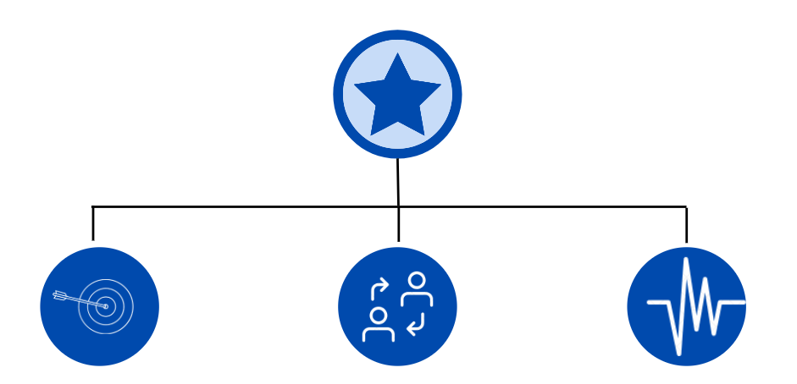
Product Vision & Strategy – North Star Matrix (NSM)
The Problem
Product Vision
PRODUCT STRATEGY
Simplify Process and digitalize spare parts catalog
Too many manual administrative for distributing information parts due to limitation user access for CAPS
Document parts need update manually if there is update too from CAPS
Web based system which has seamless, intuitive, and comprehensive platform that simplifies spare part identification, selection, and procurement, ultimately enhancing operational efficiency and provide customers and businesses interact with Mitsubishi source spare parts.
1. Average time consume by
dealer/part shop access parts
2. Conversion until realization
Awareness
1. # Number Dealer/Part shop Access
Activation
1. # Time Consume Per Access
2. # Number request data parts
Revenue
1. # Cost efficiency for provide licenses
2. # Cost efficiency for hard copy document
PT Berlian Sistem Informasi (BSI)
Confidential – Internal Used

Slide 9

Product Digital Spare Parts Catalog - Roadmap
PRODUCT VISION – Microsite Spare Part
Ecosystem which seamless, intuitive, and comprehensive platform that simplifies spare part identification, selection, and procurement, ultimately enhancing operational efficiency and provide customers and businesses interact with Mitsubishi source spare parts.
Digitalize Spare Parts Catalog
Inventory Management
AI Implementation – Sales Prediction
MMKSI
E-Commerce Spare Parts
Current
Scope
MMKSI Analytics Platform
PT Berlian Sistem Informasi (BSI)
Confidential – Internal Used

Slide 10
Microsite Spare Parts Catalogues – Product Metrics
OKR | Key Point | Key Value | Key Indicator
OKR - 1 | Reliable Apps (User tool) | Performed for 24/7 always ON, including data management protection based on Data Protection Policies. Performance Web Consist of User Experience (UX) | Conversion rate – 2 % New Customer Growth Rate - 12.5 % Churn Rate – Max 1.09 % Customer Lifetime Value - BE Performance < 5 Seconds for Information BE Performance < 2 Seconds for Transaction System offline < 2 %
OKR - 2 | Fulfilling user Needs | fulfilling user needs | Feature MY Wishlist - Utilization > 80 % Feature Share By WA , Email > 50 % Feature Download > 50 %
OKR - 3 | Daily used | As single apps to equip Application Beneficial for users. | Active Users – > 85 % Session Length > 80 %
OKR - 4 | Data Quality | Data Quality – Accuracy OCR Matching OCR and Spare Part master | Bad Quality Data < 5 % Not Available Data < 5 %
PT Berlian Sistem Informasi (BSI)
Confidential – Internal Used

Slide 11
EPICS : Simplify Process and digitalize spare parts catalog
Background
MMKSI get data vehicle spare part catalogue using CAPS which is desktop-based and get licensed applications by MMC and it can only read the data without any other party can integrated with in.
Much effort for MMKSI to provide the data from CAPS since all data should be captured and input manually to be generated as PDF format and print as hardcopy document.
Provide data manually to business partner related to spare-part information and price list, PDF format and hardcopy should be prepared and created from CAPS.
Manual update data pricing & image part due to different system access.
Initiative Solutions
Web based application to replace hardcopy document and maintain part catalogue to increase customer experience (CX) with digitalize Part Catalogue.
A system that capable to save data and upload image from CAPS then shown as Part Shop and Dealer information, allow dealer and customer to view parts detail and its prices using web application.
MMKSI able to track cookies MMKSI Digital Parts and increase spare-part and accessories sales to improve efficiency, reduce errors, and enhance collaboration with business partners.
Integrate data pricing from DNET & image capture from CAPS to visualized on microsite.
Expected Benefit
Unlimited user access for accessing parts data due to user access can be arranged according to MMKSI's needs in distributing parts data.
Centralize spare part data collected in same data source which makes it easier to be updated, add new data, and make it data more relevant with DNET.
Easy distribute parts and pricing information to dealers and part shops thereby increasing efficiency in distributing parts appropriately according to relevant information
Less duration to check parts & price on single front-end
PT Berlian Sistem Informasi (BSI)
Confidential – Internal Used
11

Slide 12

Who is the Users – User Persona
User Class
& Category
Mitsubishi Parts Shop
Mitsubishi Dealer
Mitsubishi APM
Mitsubishi Fleet Customer
❶ Occupation
❷ Marital Status
❸ Locations
❹ Tech Literature
❺ Platform Digital
❶ Spare Parts Admin
❷ Single
❸ Jakarta
❹ Low -> Medium
Able to Operate Simple
Spreadsheet.
❺ Tablet, Phone
❶ Spare Parts Admin
❷ Married
❸ Jakarta
❹ Medium. Able to Operate
Computer and Familiar with
DMS system
❺ PC Computer
❶ After Sales Team
❷ Married
❸ Jakarta
❹ Medium. Able to Operate
Computer , Tablet and
Mobile Apps and Familiar with Business Apps
(such as SAP, DMS , D-NET, etc)
❺ PC Computer,
Tablet, Mob. Apps
❶ Fleet Service Admin
❷ Married
❸ Jakarta
❹ Medium. Able to Operate
Computer , Tablet and
Mobile Apps and Familiar with Business Apps)
❺ PC Computer,
Tablet, Mob. Apps
❶ Goal
❷ Struggles
❶ Simple Apps and System can show recommendation spare parts based on stock availability
❷ Struggles
Difficult to find spare parts based on parts Number
❶ Simple Apps and System can find spare parts based on Model and Vehicle variance
❷ Struggles
Difficult to find spare parts based on parts Number
❶ Simple Apps and System can manage CMS with low effort mapping and manage data spare parts
❷ High effort to manage
The master data
❶ Simple Apps and System can integrated with fleet master data & vehicle
❷ Struggles
Manage huge number of vehicle and spare parts order.
PT Berlian Sistem Informasi (BSI)
Confidential – Internal Used
12

Slide 13
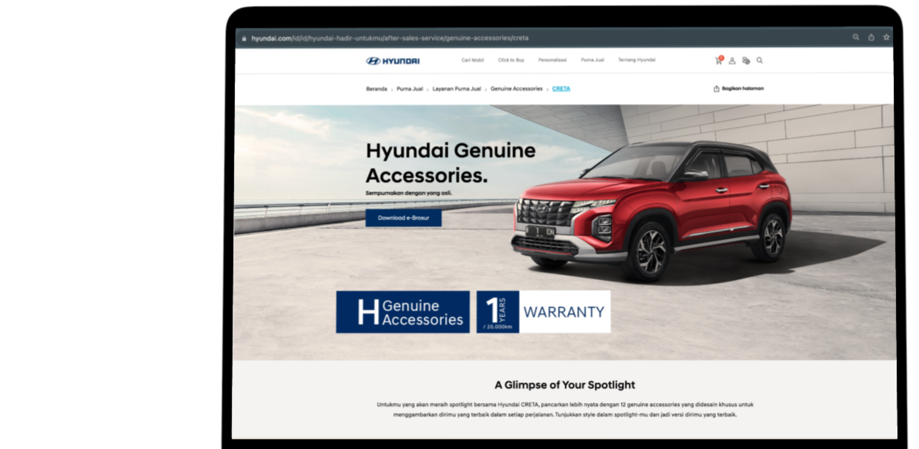
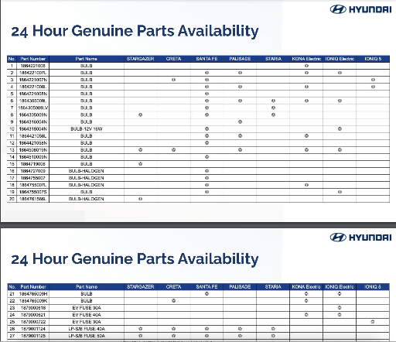
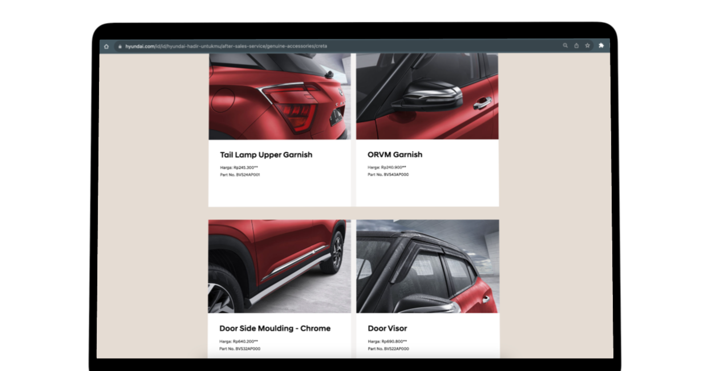
Competitor Comparison – Hyundai Digital Spare Parts
Competitor - Hyundai
24H Genuine Part Availability
Hyundai does not display detailed part catalogue and open it to the public (only certain parts can be consumed by the public)
On their website only provides certain cars and is was same like e-brochure catalogue
The information displayed on their parts catalogue are:
name of the spare part,
price
part number
PT Berlian Sistem Informasi (BSI)
Confidential – Internal Used
13

Slide 14
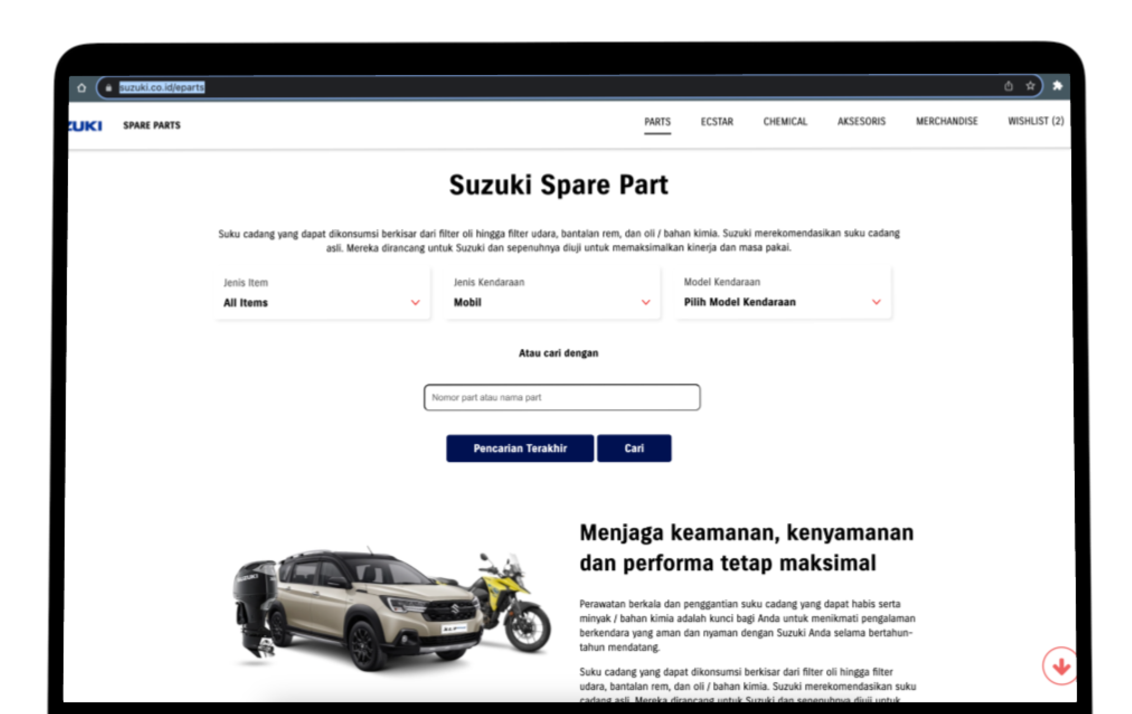
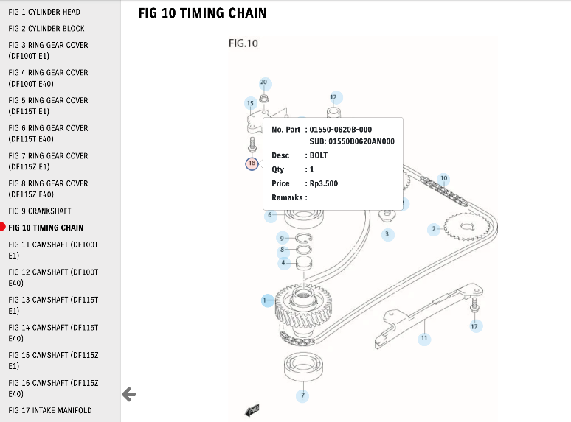
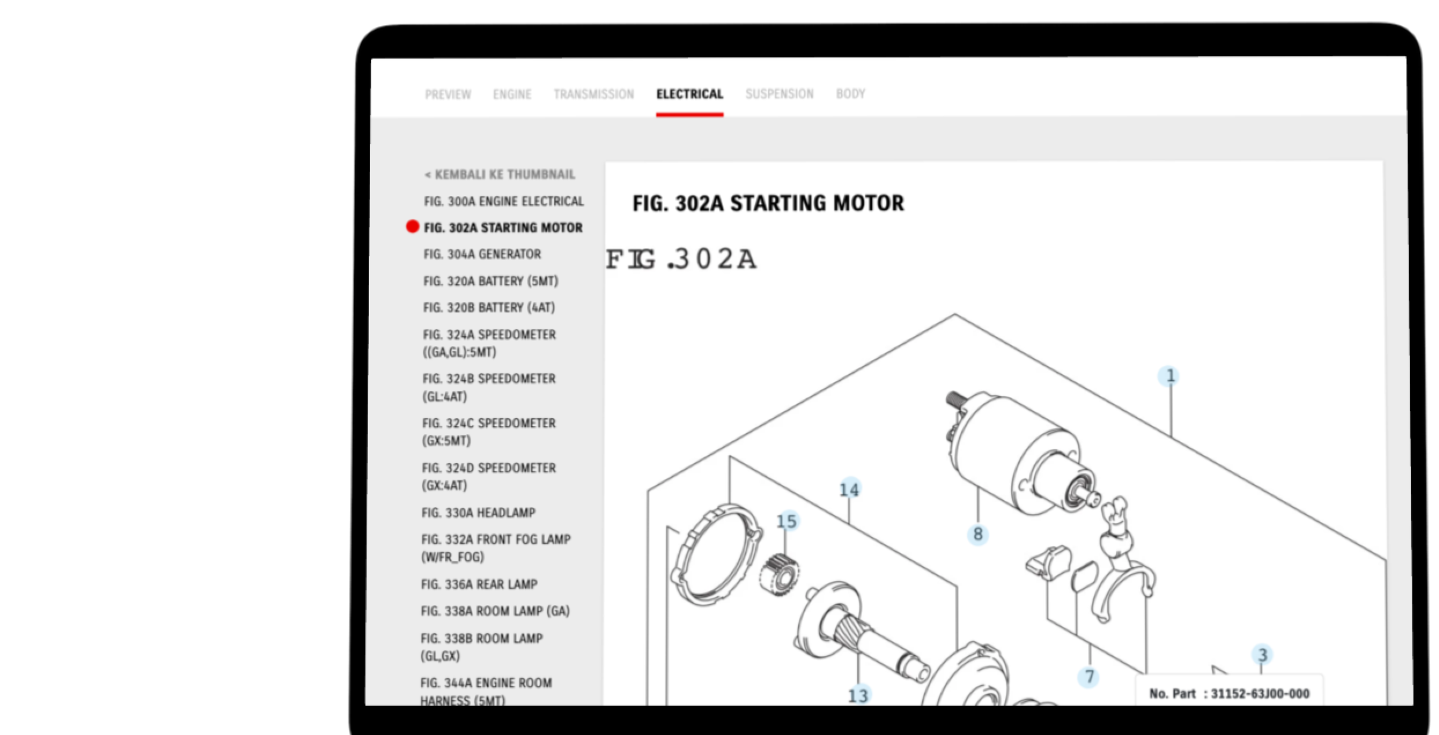
Competitor Comparison – Suzuki Spare Parts Digital
Competitor - Suzuki
Suzuki Spare part
Suzuki has a comprehensive e-catalogue list which is provided on their main website at the URL suzuki.co.id/eparts
No need to log in for accessing the system and it was available to the public
The features provided are part catalogue for motors, cars and marine
Access journey:
Users can select the vehicle category and vehicle model or enter the chassis number
The system will display parts related to the selected vehicle
The user selects the information part according to the image
There is an interactive tooltip to display part information
PT Berlian Sistem Informasi (BSI)
Confidential – Internal Used
14

Slide 15



Features – Microsite Spare Parts Catalogues – Features Responsive Website
ITD02
❶ UI Design & Platform
Responsive Website
A mobile responsive website is a website that is capable of adapting its content based on the device it is being viewed on. The layout and design of a website are generally created for desktop users.
❷Microsite Spare Parts Catalogues
CMS Portal for User Management
Transform Spare Parts Catalogues into Business Opportunities.
With Omni Channel Integration, system can track user behavior
And notify to user campaign and information. CMS system also integrated with MMKSI Backend (BE) systems such as SAP R3, D-NET , BRIGHT DMS.
ITD03
ITD04
❸Lead to Opportunity Integration
After Sales Portal.
Transform Spare Parts Catalogues into Business Opportunities.
There is features Wishlist, user can choose parts and register in MY Wishlist.
The data can be download and can be utilized for ordering process to Authorized Mitsubishi Dealer
ITD01
❶ Import Parts Catalogues
Technical drawings, code lists and price lists
Export drawings and codes from CAPS and import them with a click in CMS (Content Management System) Digital Spare Parts Catalog. System will automatically convert your file drawings and make them interactive,
PT Berlian Sistem Informasi (BSI)
Confidential – Internal Used

Slide 16
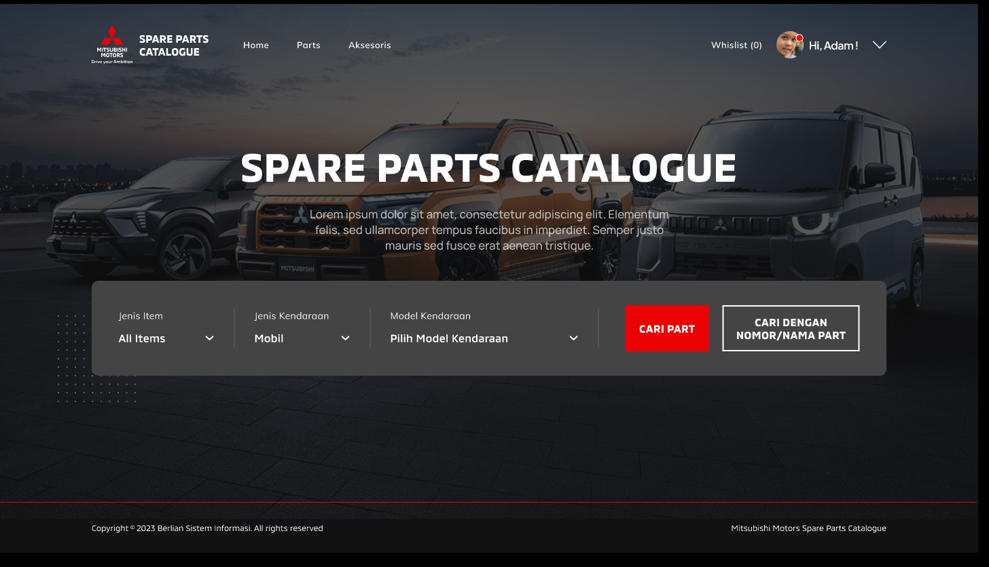
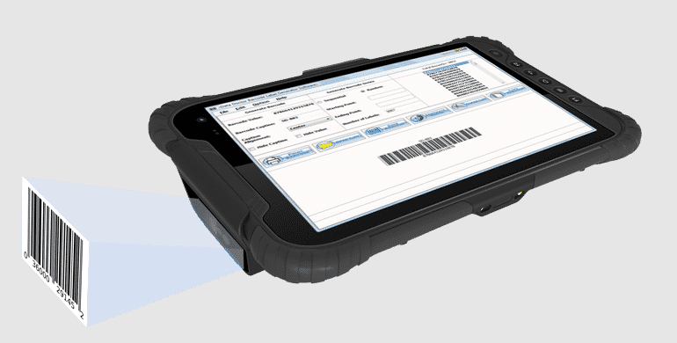
Features – Microsite Spare Parts Catalogues – Barcode Scanner Features
ITD05
❹Barcode Scanner Features
Barcode Scanner Features
User can find digital spare bar catalog based on spare parts number which is the parts filled with barcode scan from Appls
PT Berlian Sistem Informasi (BSI)
Confidential – Internal Used

Slide 17

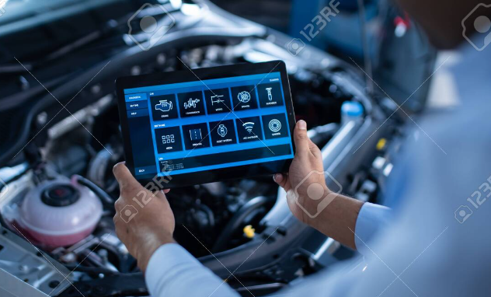
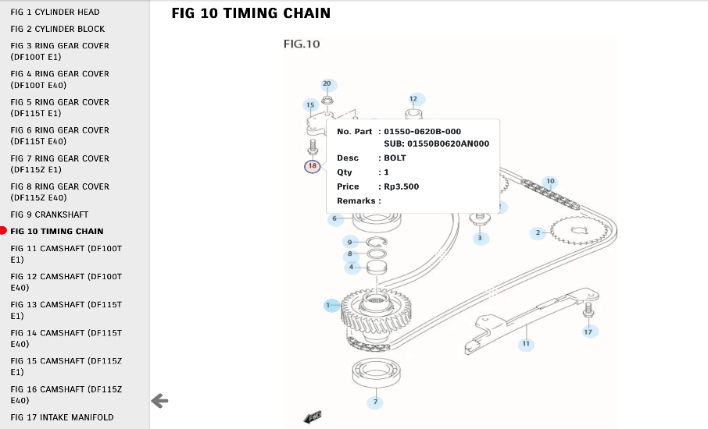
Features – Microsite Spare Parts Catalogues – AI Capture based Photo Image
❺ Microsite Spare Parts Catalogues – AI Capture based Photo Image
AI Machine Learning for find the spare parts catalog refer to image capture with device
ITD06
PT Berlian Sistem Informasi (BSI)
Confidential – Internal Used

Slide 18






High Level System Architecture
Users
Channel
v
v
v
v
❶ Parts Shop
MMKSI –
SOA API
AWS
v
Input
Data
❷ Dealers
v
SAP R3
v
Azure Vision
Generate Parts and Mapping Parts with Image uploaded in CMS Digital Part Catalog
MMKSI - Microsite Spare Part Catalog
❸ Fleet Master
Website
D-NET
v
v
v
v
MMID
DMS
CMS Microsite
❹ MMKSI
PT Berlian Sistem Informasi (BSI)
Confidential – Internal Used

Slide 19

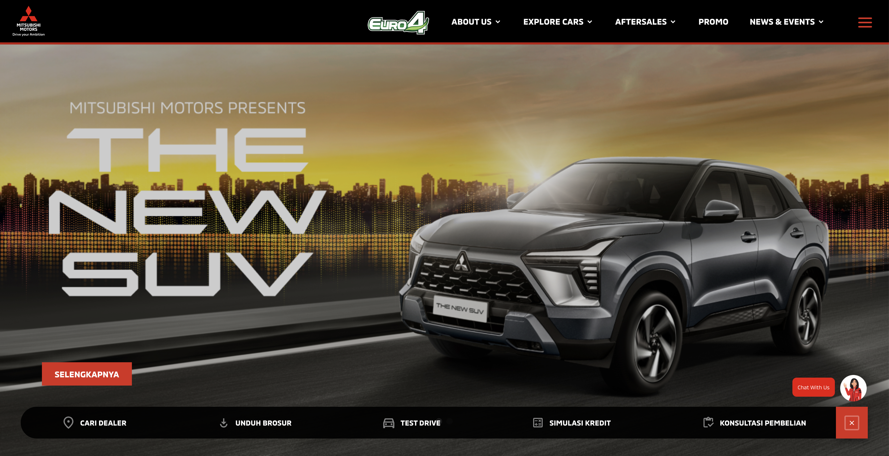
System Architecture Design
User Group
System explanation :
Azure OCR: online Artificial Intelligent OCR tools use to scan text and text location from Image. We use as tools to get PNC text and location from sparepart image as image hotspot in Part Catalogue web.
SOA Middleware : API system that supplies sparepart master and price list from D-Net system.
Backend CMS : Part Catalogue Content Management System
Part Catalogue : System that build to serve as data to front end system (web, mobile, other system)
SOA Metadata
Website
Dealer A
1
ASA Application
OCR Part Catalogue
Website MMKSI
Dealer B
2
3
4
API Part Catalogue
CMS Part catalogue
Microsite part catalogue
Non-Dealer A
DNET Application
Non-Dealer B
Admin CMS
PT Berlian Sistem Informasi (BSI)
Confidential – Internal Used
19

Slide 20
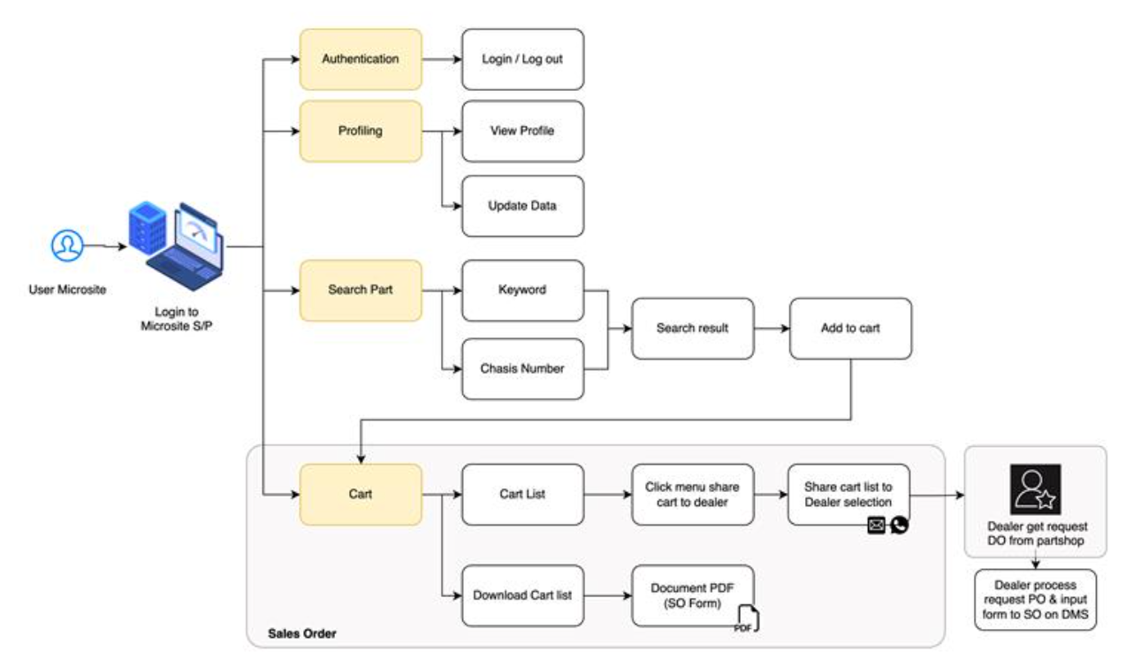
High Level User Flow – Frond End
PT Berlian Sistem Informasi (BSI)
Confidential – Internal Used

Slide 21
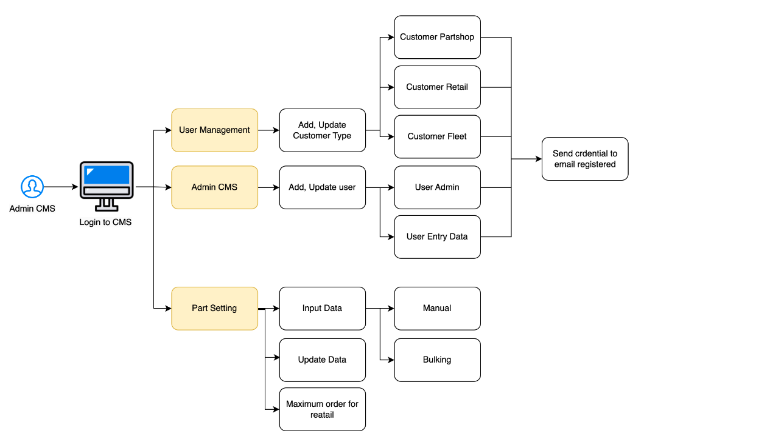
High Level User Flow – CMS Microsite
PT Berlian Sistem Informasi (BSI)
Confidential – Internal Used

Slide 22
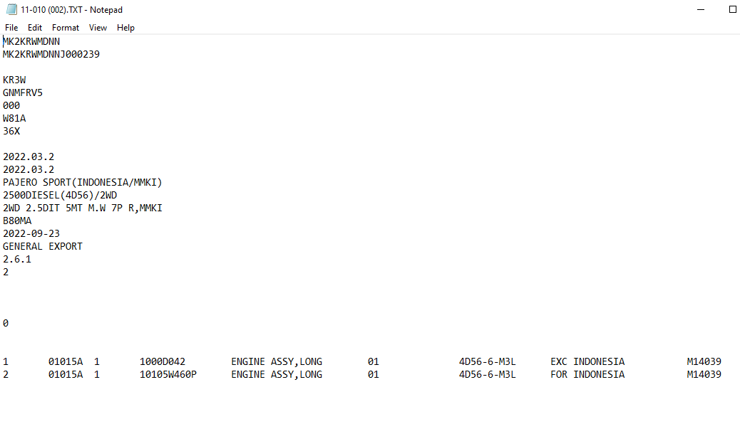
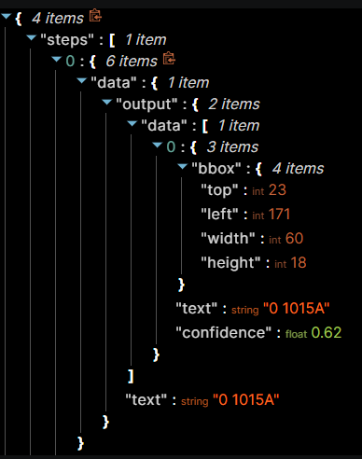
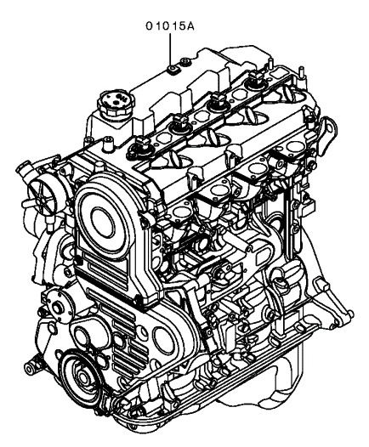
Operation Model
Description:
System can import Catalogue using export file from CAPS application
System can import image part catalogue and automatic create hotspot data (use OCR technology)
Sample export file from CAPS
Matching Data image + text
Output Sample OCR result for hotspot data
Sample image captured from CAPS
22
PT Berlian Sistem Informasi (BSI)
Confidential – Internal Used

Slide 23
Operation Model
Process of Spare Part Catalogue information distribution in MMKSI:
1
4
Process Flow Detail :
BSI will assist MMKSI for extracting information’s from ASA Application of
Parts data and Parts image.
Upload data to Parts Catalogue Application
SAP application integrated with Mitsubishi Part catalogue for spare parts price information integration.
Mitsubishi
ASA (CAPS) Application
Dealer A
3
Mitsubishi
Part Catalogue
Application
Dealer B
Information of parts detail and price will be displayed in Mitsubishi Part Catalogue.
Dealer user and Part shops user will open Mitsubishi Parts catalogue to access Spare parts information.
MMKSI User
2
Partshop A
Mitsubishi
SAP Application
Partshop B
23
PT Berlian Sistem Informasi (BSI)
Confidential – Internal Used
23
1

Slide 24
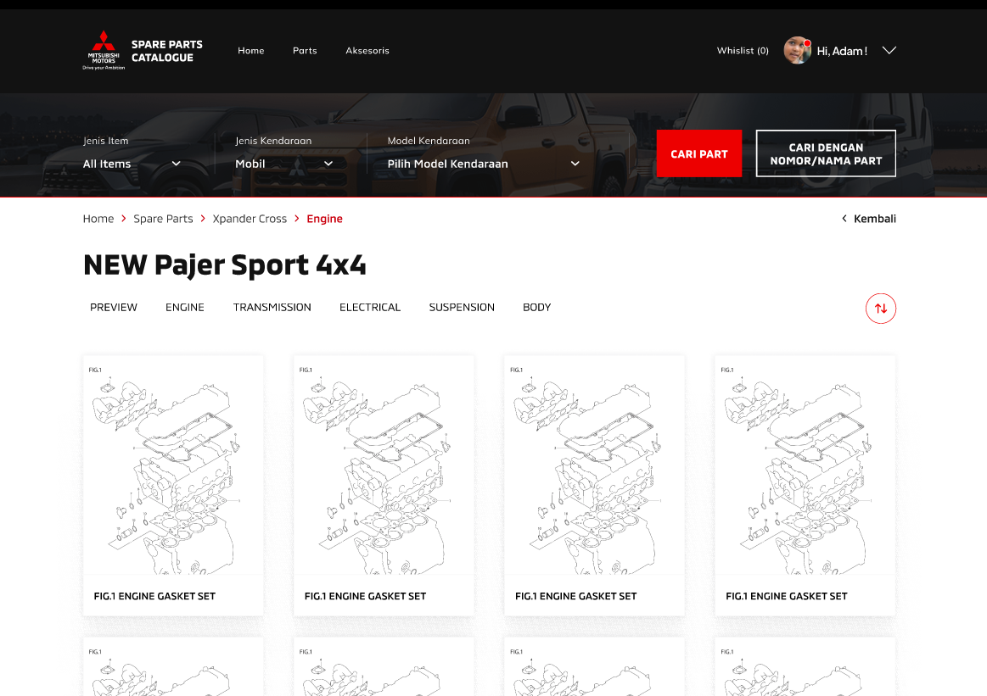
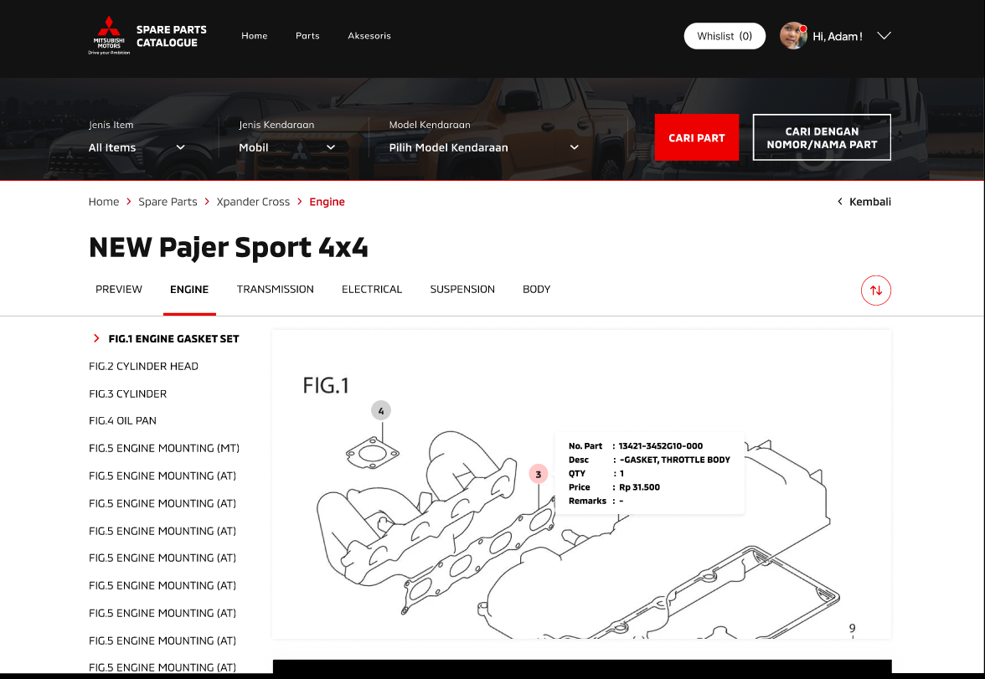
Microsite – High Fidelity
https://www.figma.com/proto/JEOSl5qNO3EiBt8Iitxlsh/MMID---Spare-Part-Catalogue?page-id=0%3A1&type=design&node-id=31-6095&viewport=-1032%2C-7%2C0.17&t=PNOtiP6dDRnknBHI-1&scaling=scale-down&starting-point-node-id=31%3A6095&mode=design
PT Berlian Sistem Informasi (BSI)
Confidential – Internal Used
24

Slide 25
Prioritization Matrix Approach and Methodology
Prioritization Matrix Approach
Financial Department
Quick Wins
Transformational Projects
Quick Wins (High Impact, Low Effort)
Transformational Project (High Impact, High Effort)
“Fill Ins” (Low Impact , Low Effort)
“Money Pits” (Low Impact , High Effort”
ITD01
ITD02
ITD04
ITD05
High
ITD03
ITD06
Business Impact
Medium
“Fill Ins”
“Money Pits”
Scope Current EPICS
❶ Import Parts Catalogues
❶ UI Design & Platform
❷Microsite Spare Parts Catalogues
Low
Implementation Efforts
Low
Medium
High
PT Berlian Sistem Informasi (BSI)
Confidential – Internal Used
25

Slide 26
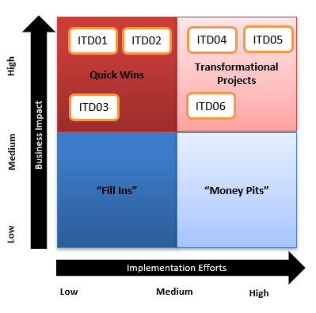
Features – Microsite Spare Parts Catalogues – Features Responsive Website
❶ Import Parts Catalogues
Technical drawings, code lists and price lists
Export drawings and codes from CAPS and import them with a click in CMS (Content Management System) Digital Spare Parts Catalog. System will automatically convert your file drawings and make them interactive,
ITD01
ITD02
❶ UI Design & Platform
Responsive Website
A mobile responsive website is a website that is capable of adapting its content based on the device it is being viewed on. The layout and design of a website are generally created for desktop users.
ITD03
❷Microsite Spare Parts Catalogues
CMS Portal for User Management
Transform Spare Parts Catalogues into Business Opportunities.
With Omni Channel Integration, system can track user behavior
And notify to user campaign and information. CMS system also integrated with MMKSI Backend (BE) systems such as SAP R3, D-NET , BRIGHT DMS.
PT Berlian Sistem Informasi (BSI)
Confidential – Internal Used

Slide 27
Group Features – Microsite Spare Parts Catalogues - Responsive Website
ITD01
List of Features
Features import image from ASA
Parts data in Txt format
Parts image in jpg format
2. OCR Azure Vision
a. Capture image and auto mapping
with spare part master data
b. Feature Multiple File
❶ Import Parts Catalogues
Technical drawings, code lists and price lists
Export drawings and codes from CAPS and import them with a click in CMS (Content Management System) Digital Spare Parts Catalog. System will automatically convert your file drawings and make them interactive,
ITD02
List of Features
Auto Responsive content to tablet
Auto Responsive content to Mon. Apps
❶ UI Design & Platform
Responsive Website
A mobile responsive website is a website that is capable of adapting its content based on the device it is being viewed on. The layout and design of a website are generally created for desktop users.
ITD03
List of Features
Tracking Behaviors using GA4
Tracking Behaviors with Omni Channel (MoE)
Integration with Email, WA
Feature Download
❷Microsite Spare Parts Catalogues
CMS Portal for User Management
Transform Spare Parts Catalogues into Business Opportunities.
With Omni Channel Integration, system can track user behavior
And notify to user campaign and information. CMS system also integrated with MMKSI Backend (BE) systems such as SAP R3, D-NET , BRIGHT DMS.
PT Berlian Sistem Informasi (BSI)
Confidential – Internal Used

Slide 28
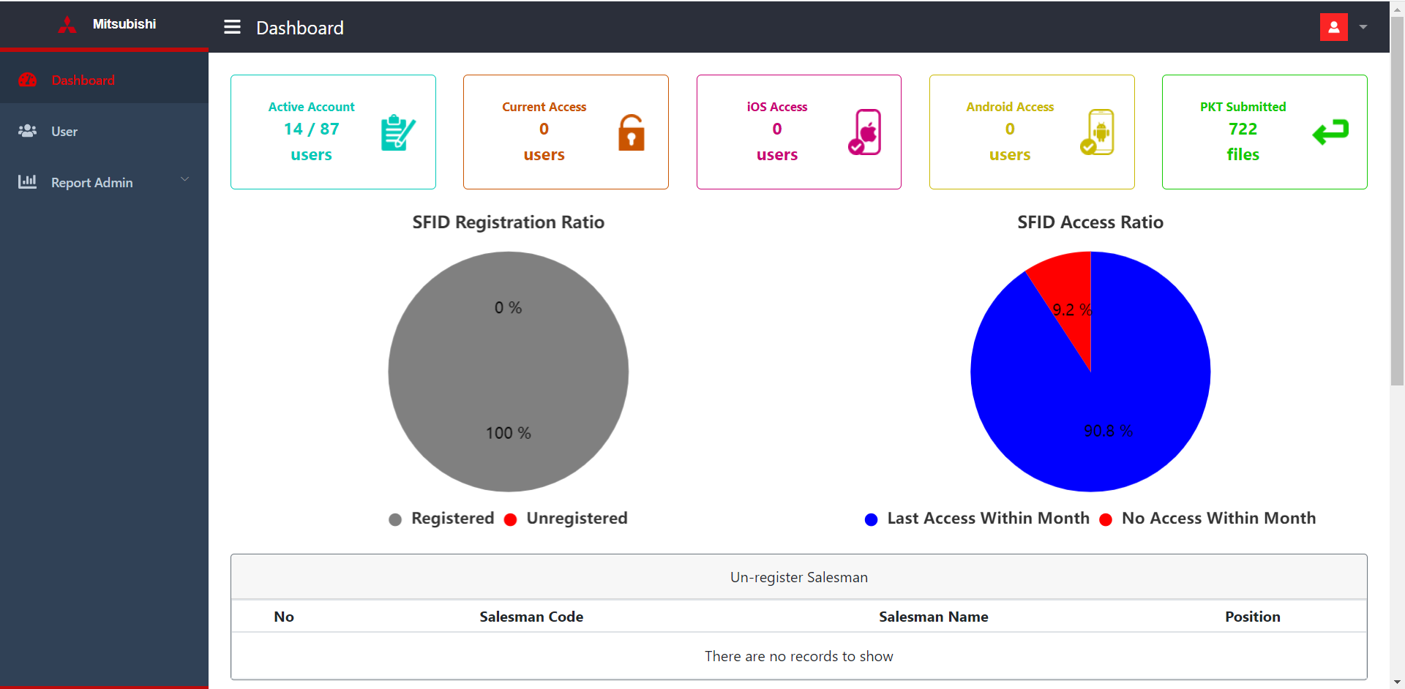
How to Monitor
Description: How to Monitor Refer Product Matrics
28
PT Berlian Sistem Informasi (BSI)
Confidential – Internal Used
28
Notes:
Top: koordinat atas
Left: kiri bawah
Widh: lebar
Height: tinggi koordinat

Slide 29
Milestone
Release Schedule and Program Status
 |  | Not Started |  | In Progress (On Target) |  | In Progress (Risk of Delay) |  | Delayed (Start/ End) |  | Completed
We‘re here
2023
2024
 | Oct | Oct | Nov |  | Dec |  | Dec |  | Nov |  |  | Jan |  | Dec |  | Feb |  | Jan |  | Mar |  |  |  | Apr
 | W3 | W4 | W1 | W2 | W3 | W4 | W1 | W2 | W3 | W4 | W5 | W1 | W2 | W3 | W4 | W1 | W2 | W3 | W4 | W1 | W2 | W3 | W4 | W1 | W2
Requirement Analysis & Mockup
Development SOA
Development CMS Parts
Development Microsite
Acceptance Test
Data Migration & Dashboard Monitoring
Go Live
Stabilization & Operational
Kick-Off
31-Oct-23
SCOPE SUMMARY
Develop Content Management System (CMS) to accommodate data input and update parts Develop integration with other system related to spare part digitalization Develop digitalized spare part catalog to replace hardcopy document and maintain spare part data Loading / migration data from local to CMS system
Notes:
Depency dari MMKSi perlu di state di part ini, alokasi / aktivitas yang perlu dilakukan oleh MMKSI

Slide 30

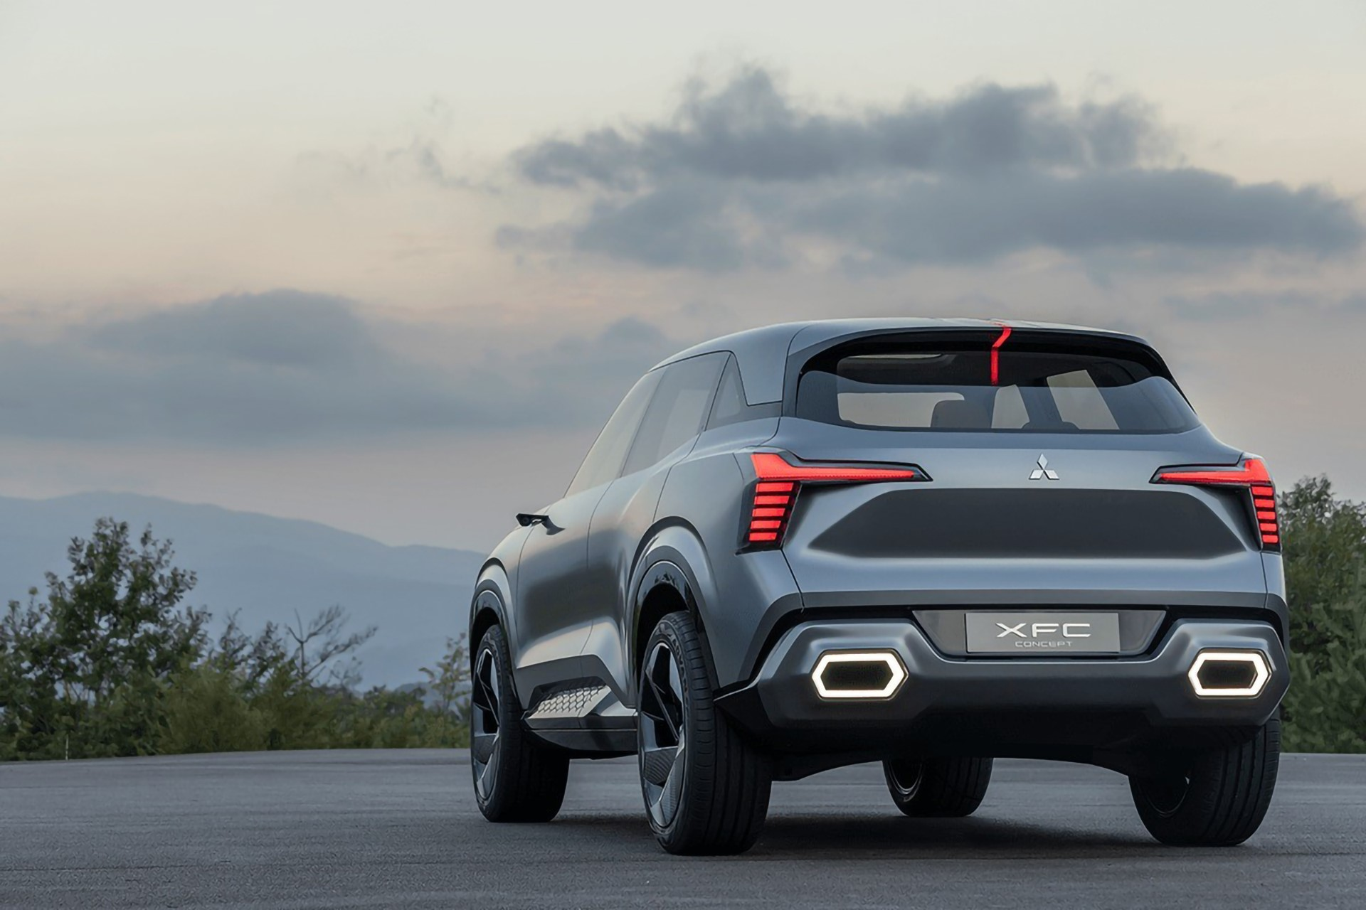

End Off Slides
Thank you!

